Slide 1
Final Report
01
519H0295 - Nguyen Le Ngoc Huy

Slide 2
CONTENTS
1
Data Mining
2
Data Preprocessing
Crawl stock price history
Time Series Scaler Mean Variance
3
Data Clustering
Time Series K-means

Slide 3
Data Crawling
01
01
Crawling price history

Slide 4
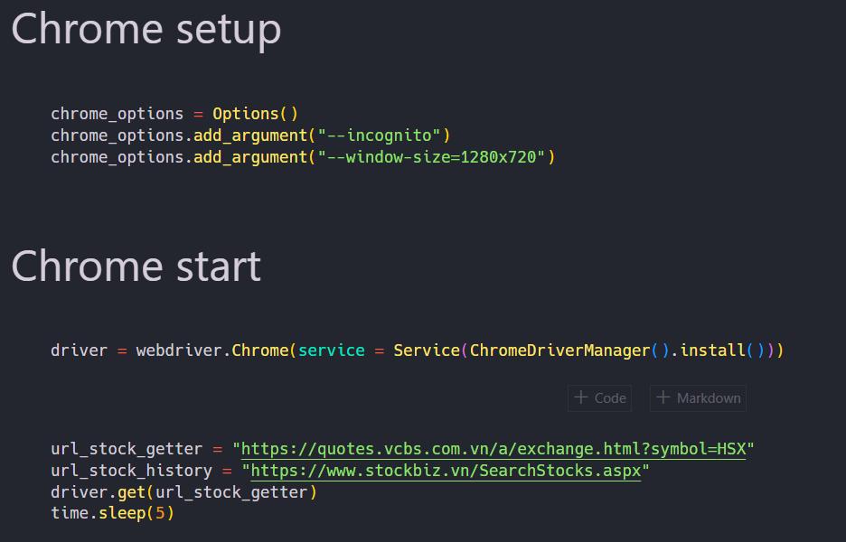
Chrome Driver Setup

Slide 5
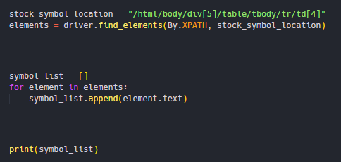
Crawl stock symbols

Slide 6
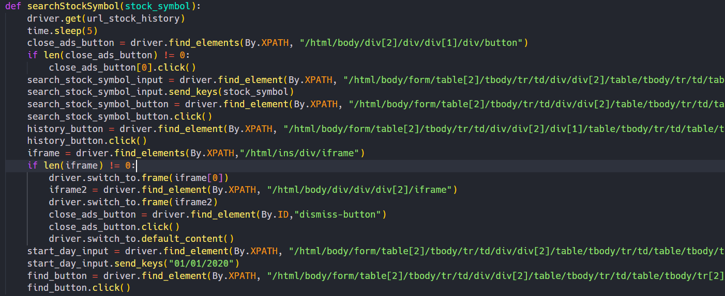
Open history price function

Slide 7
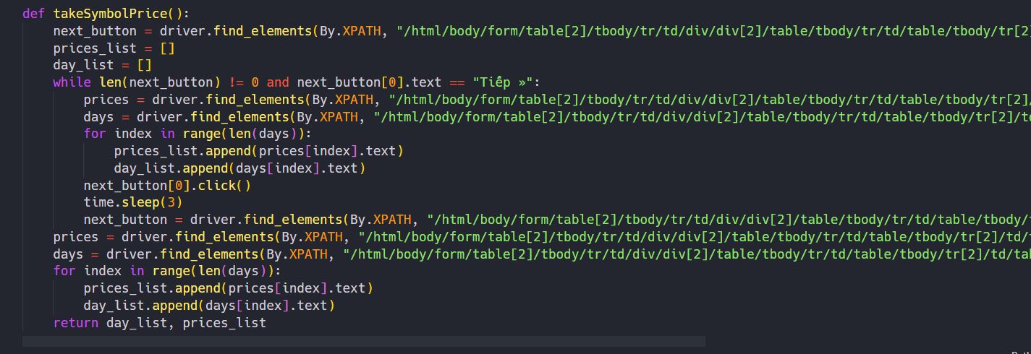
Price Crawling Function

Slide 8
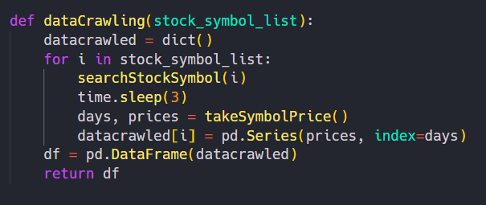
Multi Symbol crawling function

Slide 9
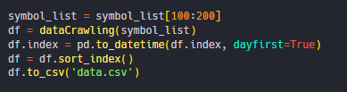
Start crawling

Slide 10
Data Preprocessing
01
02
Time Series Scaler Mean Variance

Slide 11
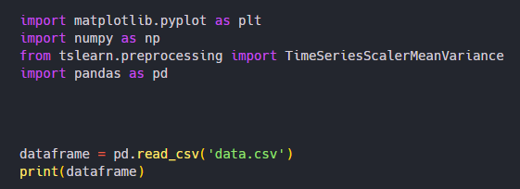
Some libraries

Slide 12
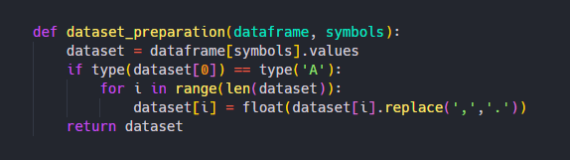
Dataset preparation function

Slide 13
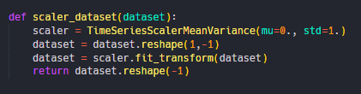
Scaler function

Slide 14
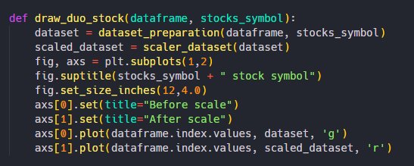
Ploting dataset

Slide 15
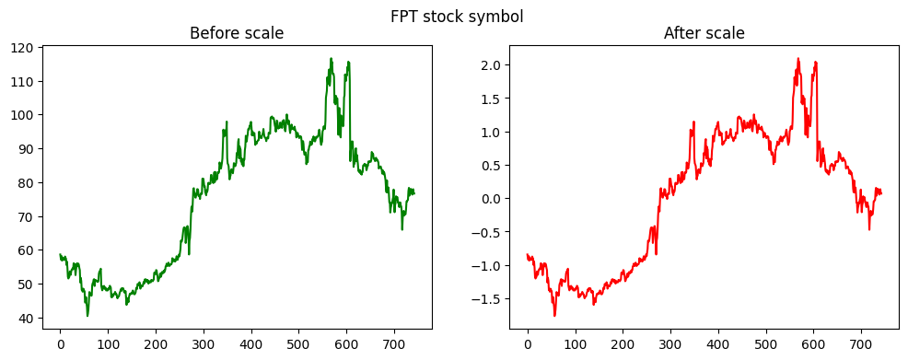
Scale Result

Slide 16
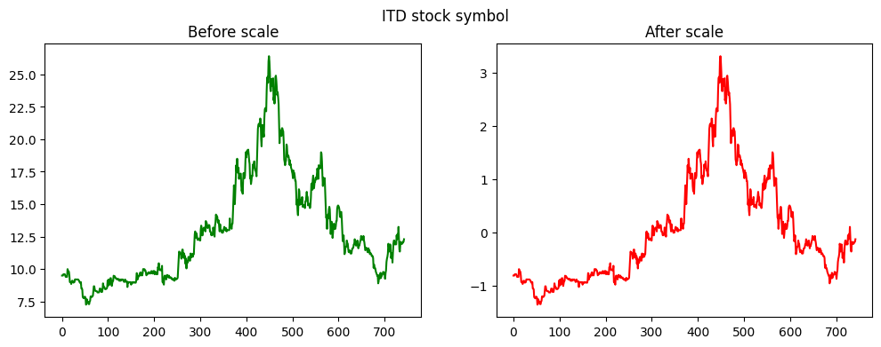
Scale Result

Slide 17
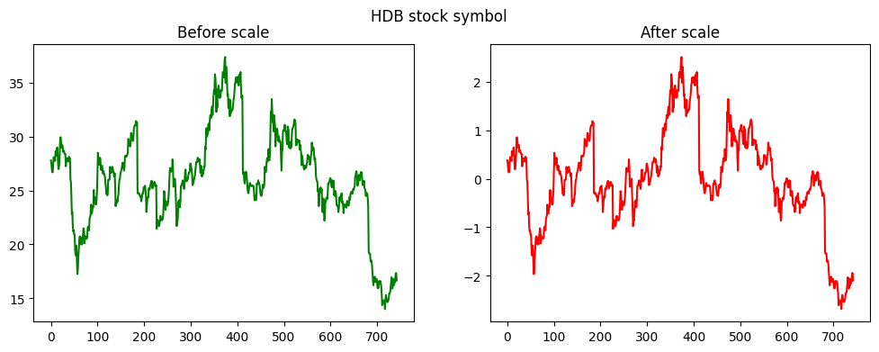
Scale Result

Slide 18
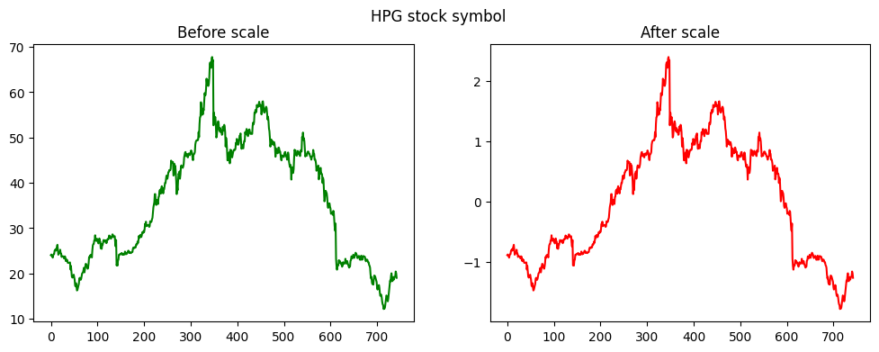
Scale Result

Slide 19
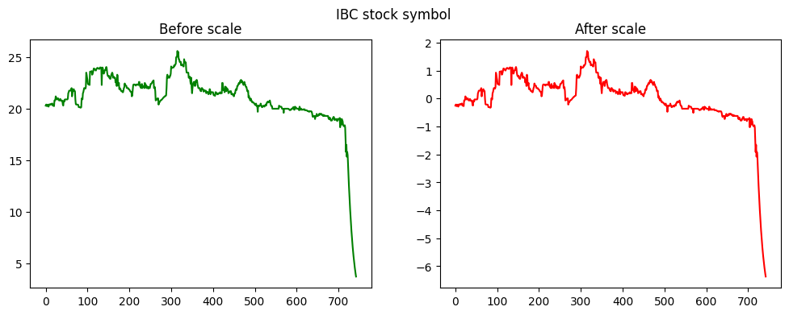
Scale Result

Slide 20
Data Clustering
01
03
Time Series K-means clustering

Slide 21
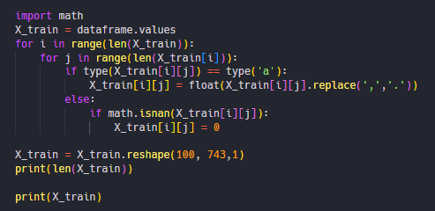
Preprocessing data

Slide 22
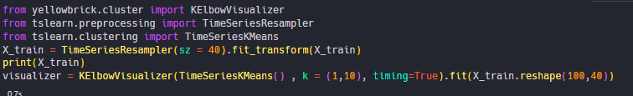
Shortening and calculating elbow

Slide 23
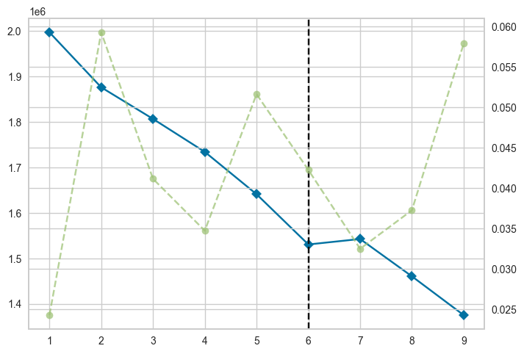
Elbow Result

Slide 24
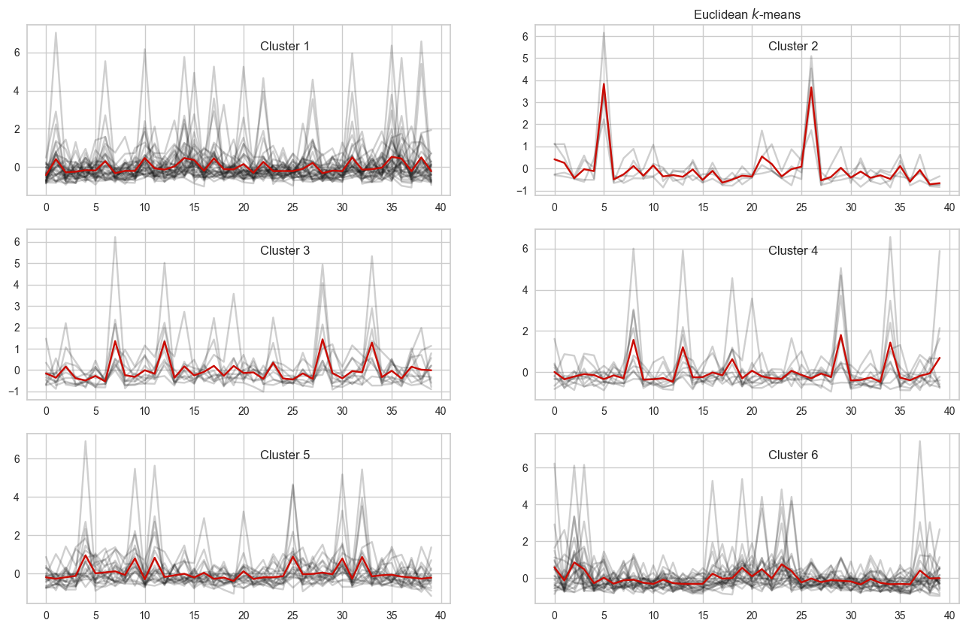
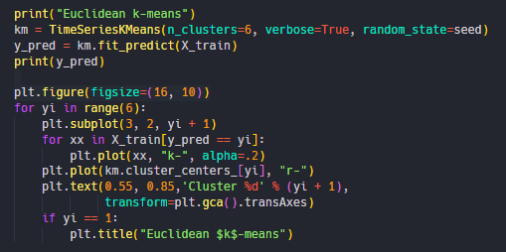
Euclidean k-means

Slide 25
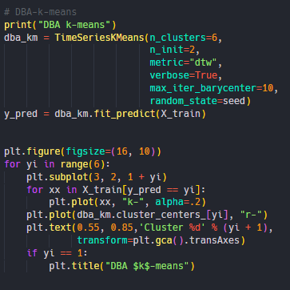
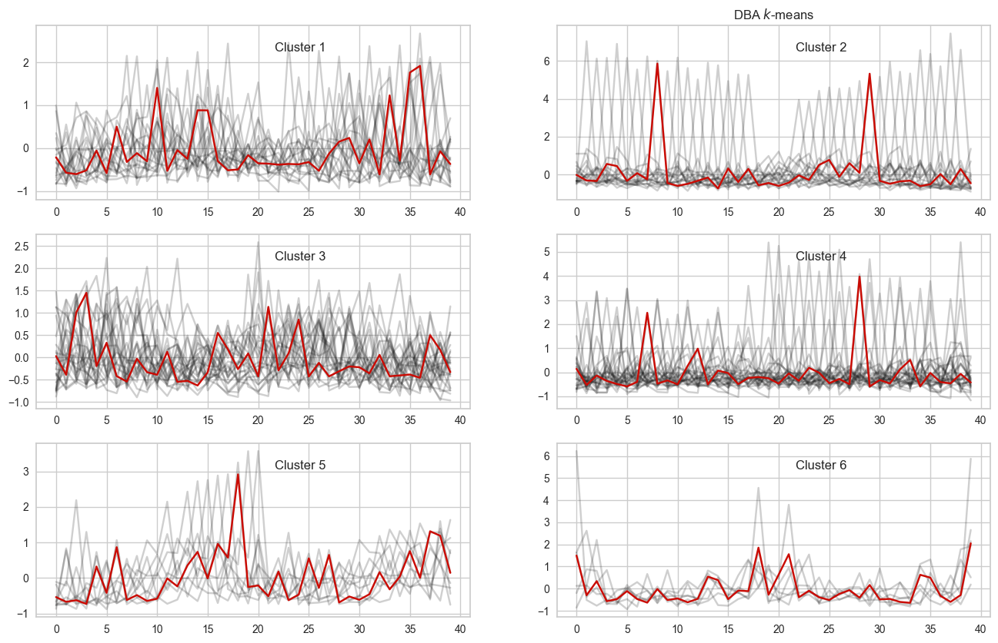
DBA k-means

Slide 26
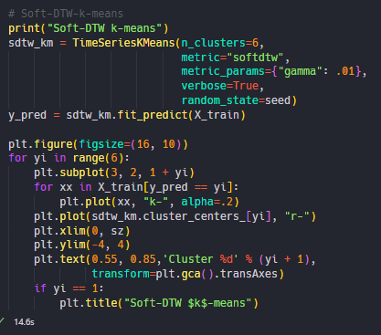
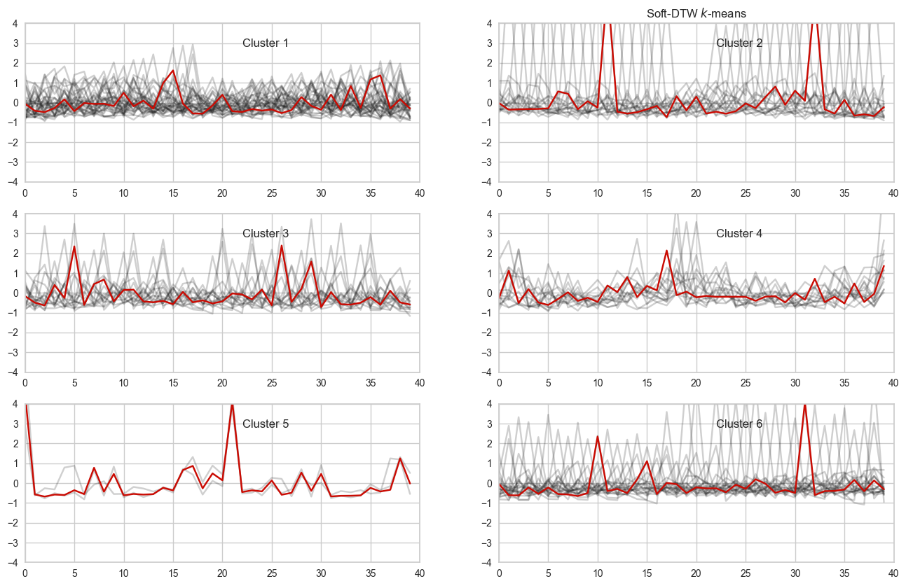
Soft-DTW k-means

Slide 27
THANKS
For Watching

